Slide 1
Measuring the Distance People in Need Travel to Food Pantries
DATA CRUNCH FOR SOCIAL GOOD
RITA BENNETT-CHEW, SARAH GAUBY, SHARIQ IQBAL, ERICA LEVINE,
BHARATHKUMAR RAMACHANDRA, SUZY STIEGELMEYER

Slide 2
Overview
North Carolina counties in our analysis
  Durham
  Johnston
  Orange
  Wake
Analysis
  Calculated the distance from the census tracts to the food pantries
  Observed the trends among households that received food stamps compared to their distance from food pantries

Slide 3
Methodology
Information by census tract
Make a shape file of the four counties of North Carolina on which we focused
Convert the GEO ID’s into longitudes and latitudes.
Find the minimum Euclidean distance from the centroid point of a census tract to the food pantries.
Notes:
Merging the shapefile of NC census tracts with census tracts from ACS based on GEO ID to get another shapefile. This new shapefile only encompassed the four counties in which we were interested. Then we converted this shapefile into a data frame in order to then (2) convert the GEO ID’s into longitudes and latitudes that could be plotted on a map. Next we calculated the distance of the people in need to the food pantries. Due to privacy issues, we cannot know the actual locations of the households in need. Therefore, we used the centroid of the census tract as a central location of these populations. The ACS data contained the longitude and latitude of the centroid point of each of the census tracts. We calculated the Euclidean distance from each centroid point to all of the food pantries. Then we (3) found the minimum distance, which is the distance we graphed and compared.

Slide 4
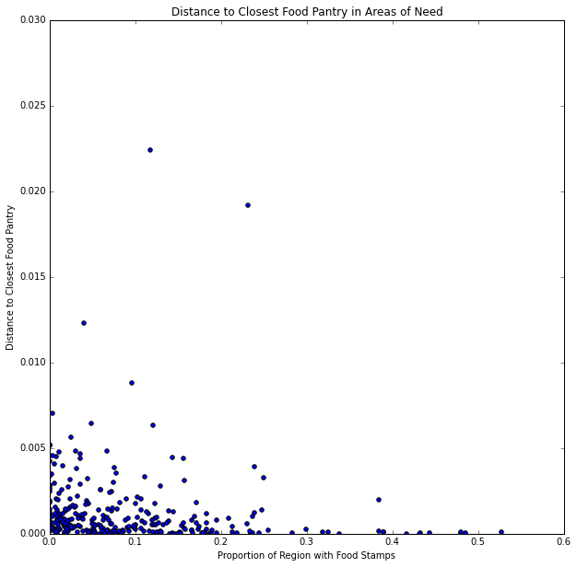
Notes:
Figure 1: This graph shows the distance from the center of the census tract to the closest food pantry compared to the proportion of households receiving the food stamps. It is helpful in identifying those two counties that should be investigated for lack of food options

Slide 5
Notes:
Figure 1: This graph shows the distance from the center of the census tract to the closest food pantry compared to the proportion of households receiving the food stamps. It is helpful in identifying those two counties that should be investigated for lack of food options

Slide 6
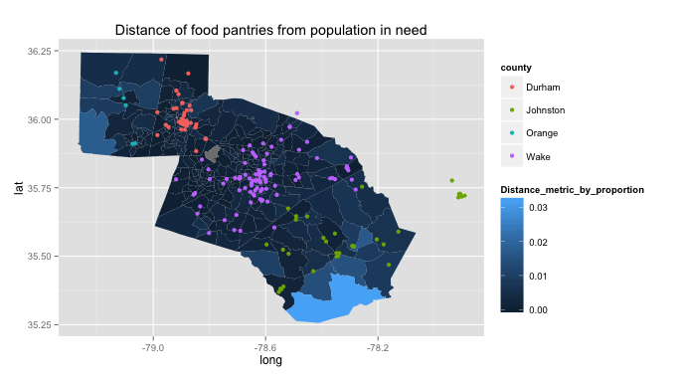
Notes:
Figure 2: This graph shows a heat map of the distance metric on a census tract level. The distance metric multiplies the proportion of households receiving food stamps by the minimum distance from the centroid of the census tract to the closest food pantry. The lighter the color the larger the distance metric, meaning that both the proportion of households receiving food stamps and the distance to food pantries are large. These are the census tracts that you should investigate further.

Slide 7
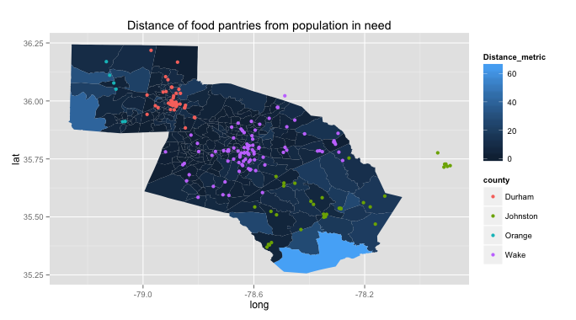
Notes:
Figure 3: This graph shows a heat map of the distance metric on a census tract level. The distance metric multiplies the proportion of households receiving food stamps by the minimum distance from the centroid of the census tract to the closest food pantry. The lighter the color the larger the distance metric, meaning that both the proportion of households receiving food stamps and the distance to food pantries are large. These are the census tracts that you should investigate further.

Slide 8
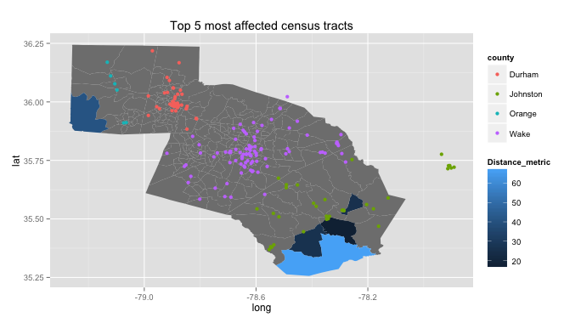
Notes:
This graph focuses in on the most affected census tracts

Slide 9
Recommendations
Investigate the following census tracts
  413 Johnston County
  112.03 Orange County
Future Research
  Similar analysis but use different variables:
    People who receive WIC
    People who receive SNAP
    Locations of feeding sites

